Slide 1


RCTrep: An R Package for the Validation of Estimates of the (conditional) Average Treatment Effect
Lingjie Shen
2025.3.28 shanghai

Slide 2
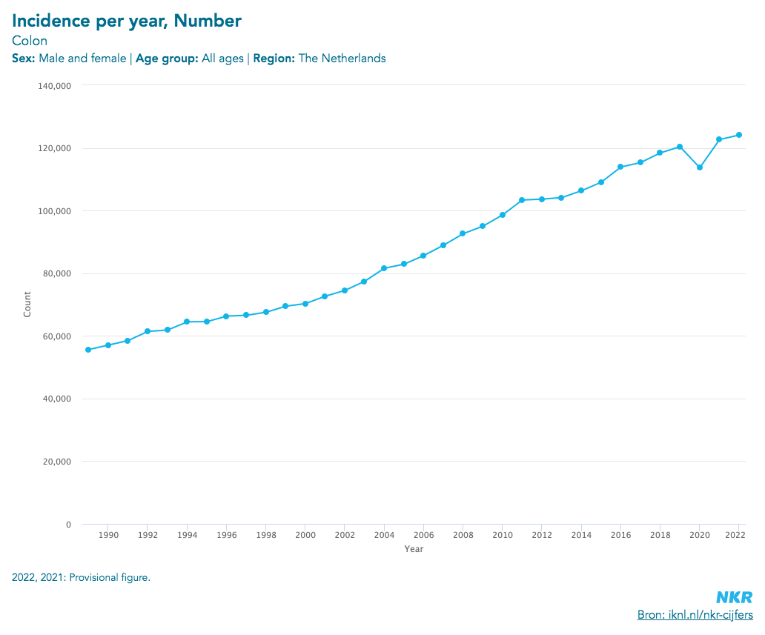

Background
Modern evidence-based medicine puts RCTs and meta-analysis at the core of the best clinical evidence.

Slide 3

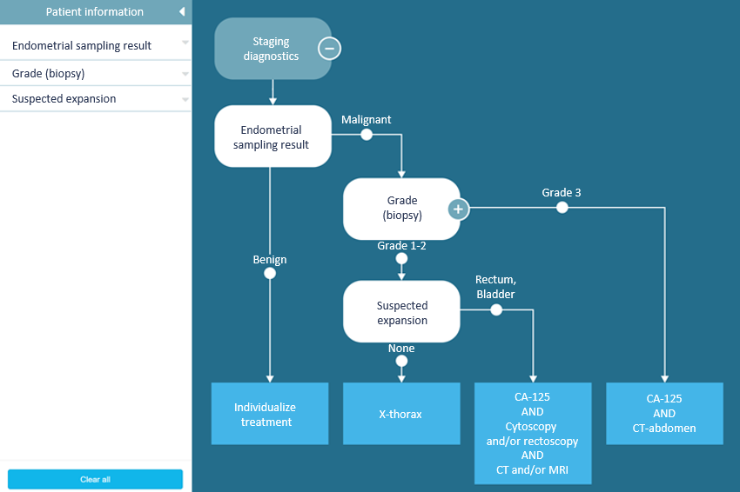


Background
Observational data
Clinical Decision Tree
Can I trust you?

Slide 4

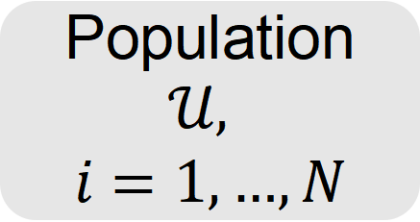
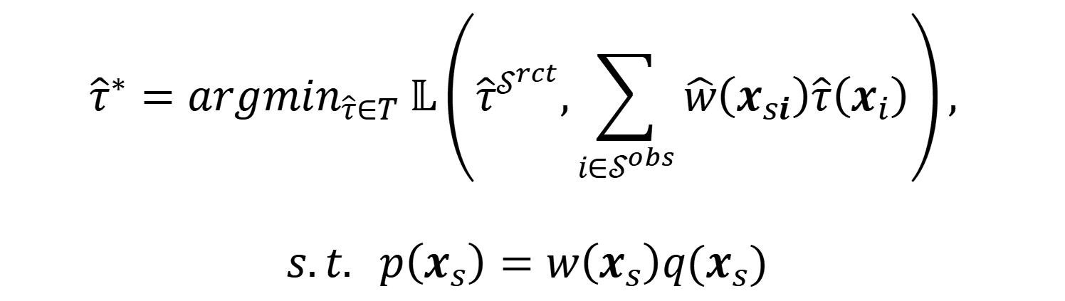
Objective
Existing tools: MethodEvaluation , causality-Benchmark, justcause, etc.
RCTrep aims to validate causal effect estimates obtained from observational data using real RCT data.
Population $𝒰,$
$$i=1,…,N$$
$${\hat{τ}}^{∗}={argmin}_{\hat{τ}∈T} 𝕃\left({\hat{τ}}^{𝒮^{rct}},\sum_{i∈𝒮^{obs}}{\hat{w}\left(x_{si}\right)\hat{τ}\left(x_{i}\right)}\right),$$
$$s.t. p\left(x_{s}\right)=w\left(x_{s}\right)q(x_{s})$$
RCT
obs

Slide 5

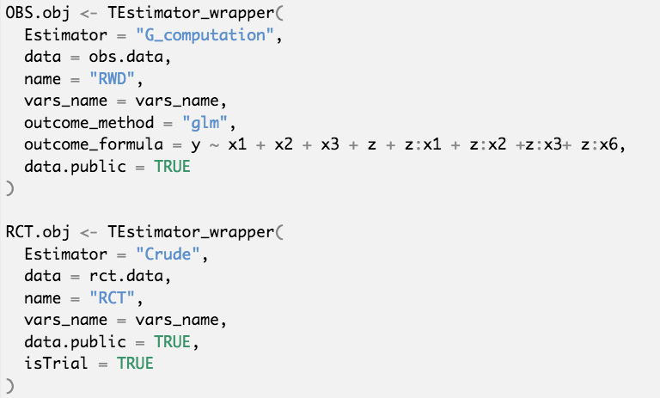
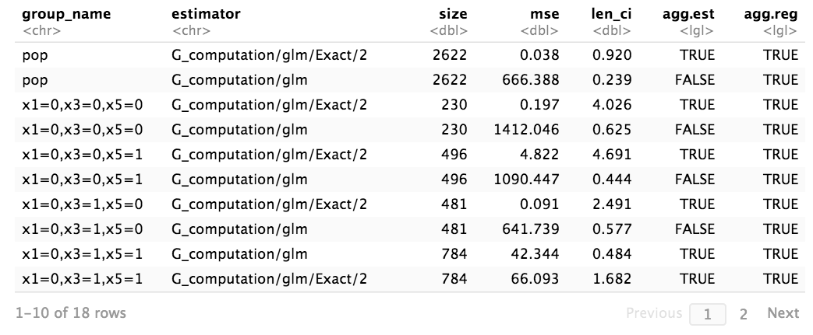
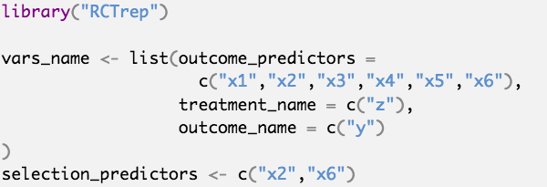
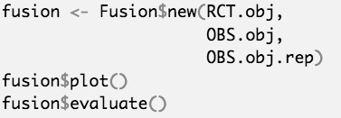
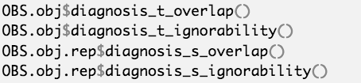
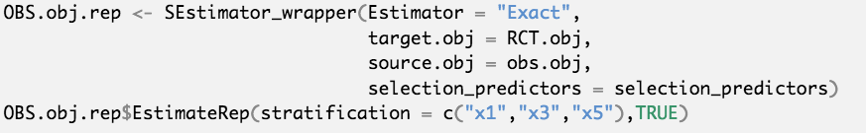
Quick start
Set-selection
diagnosis
Set-selection
Estimation
Estimation
diagnosis
validation
validation
RCT
obs

Slide 6
Conclusions
Limitations
We don’t have individual-level RCT data or p(x) assessing the same treatment
Two datasets are selected from the same population and the selection probabilities are known
Bonus
Add to our understanding when and how to validate
Provide a possibility to validate
Reflect the role of observational data in decision making and evidence generation (e.g., make RCT better)

Slide 7
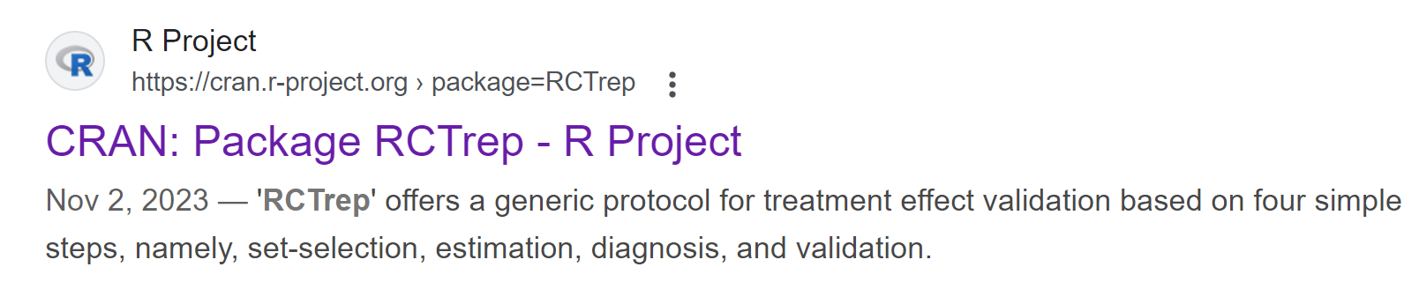

For more implementation and statistical details...
R package
paper

Slide 8

南京白色巨塔临床医学研究有限公司
Nanjing White Tower Clinical Medical Research Co., Ltd
A I • 200万医生 • 真实世界研究 • 智能平台
白塔数据
www.onetopdata.com
2025 上海

